Slide 1
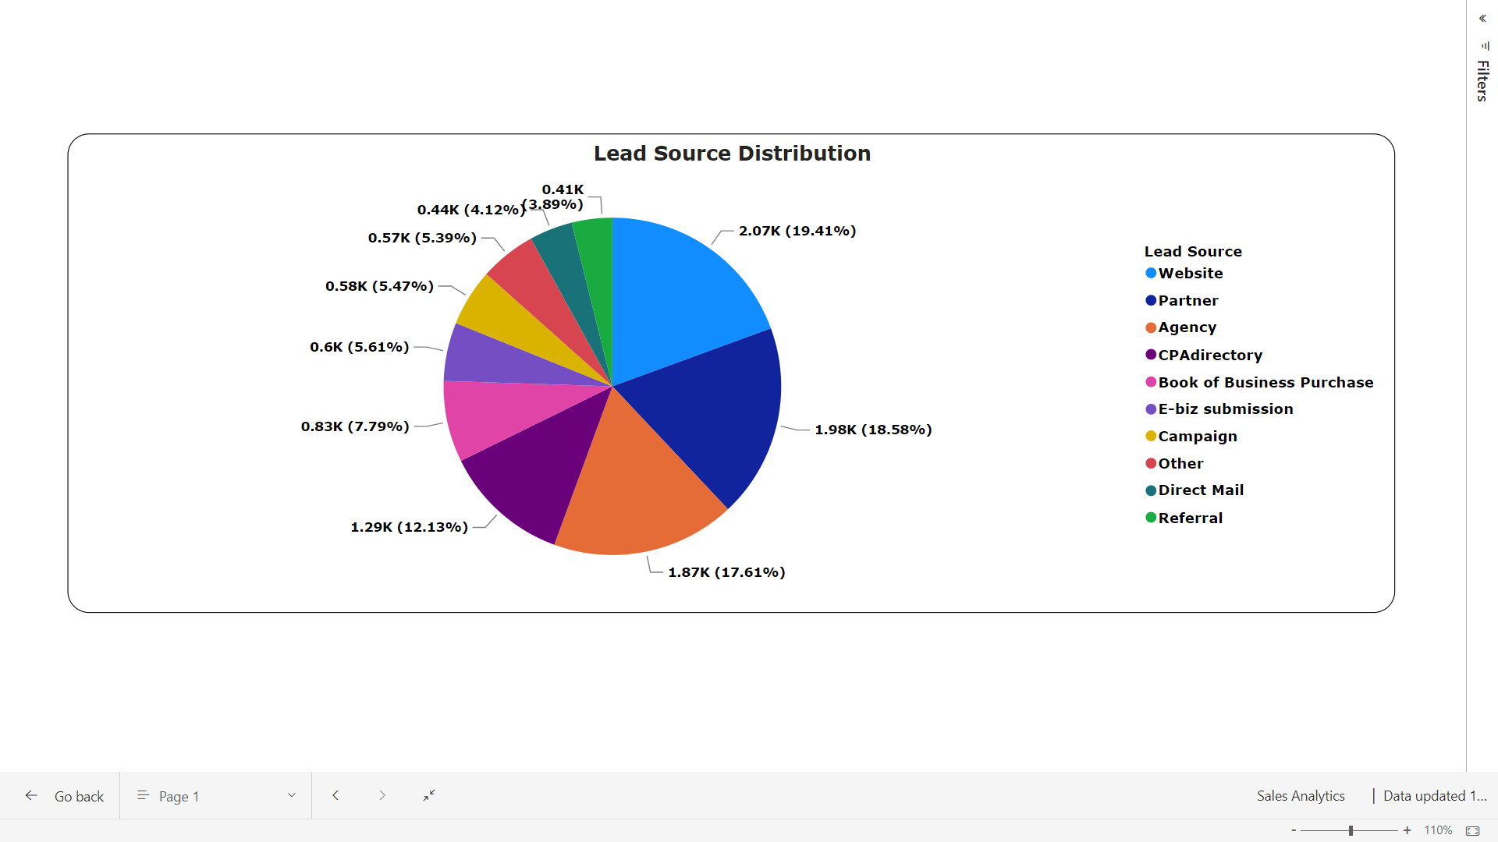
Distrubution
Websites, Partners, Agencies and CPAs generate substantial opportunities.

Slide 2
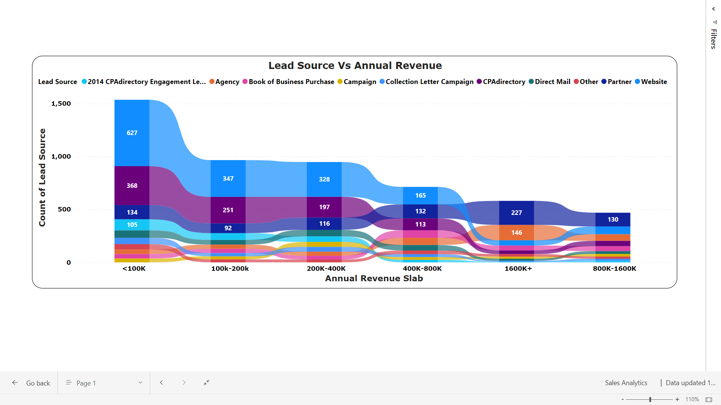
Strategic Annual Revenue Opportunities:
Utilizing the Website’s true potential can convert a lot of opportunities across all revenue slabs.
On the higher revenue side we can improve our focus on agency and partner for converting opportunities.

Slide 3
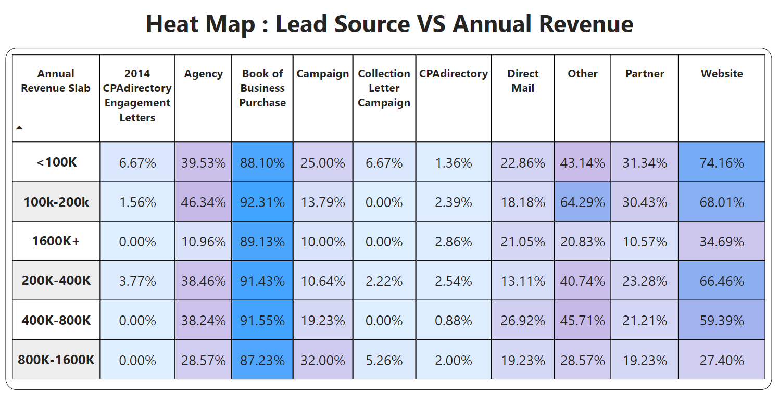
Leverage the success of Book of Business Purchase and Referrals by allocating additional resources and marketing efforts towards these channels.
Alarmingly low conversion ratio for CPAdirectory. Need to investigate and optimize our approach on CPAdirectory.
Tailor approaches for high-revenue leads across various sources, personalized incentives or specialized engagement strategies to improve conversion rates.
Evaluate and refine the website's engagement process, possibly by introducing targeted offers or user-friendly features.

Slide 4
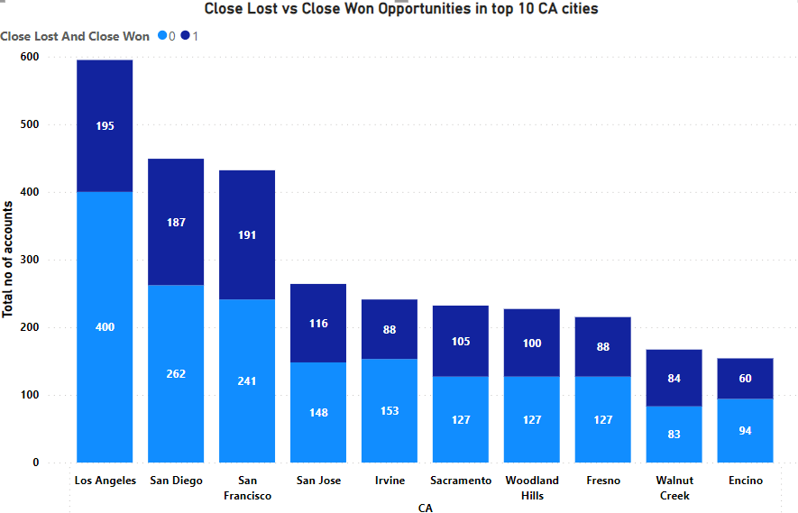
Los Angeles, San Diego and San Francisco cities showcase abundant opportunities, but exhibit lower success rates.
Exploring strategies to optimize our approach in these key markets can enhance our performance.

Slide 5
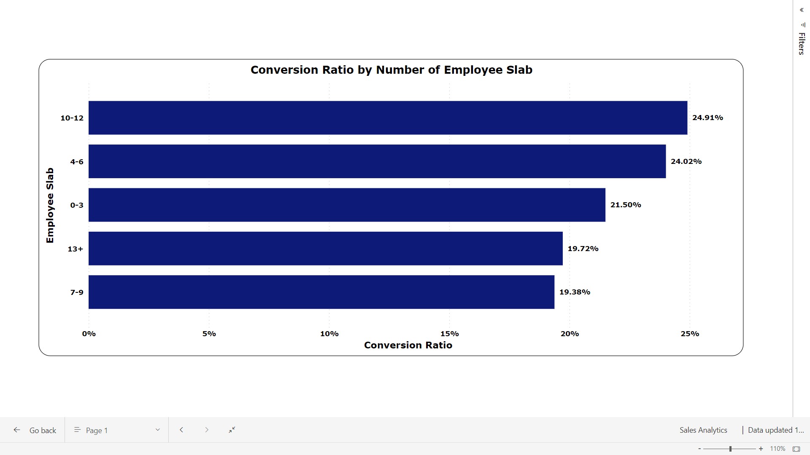
The changing scenario of number of employees leads to a fluctuating conversion ratio.

Slide 6
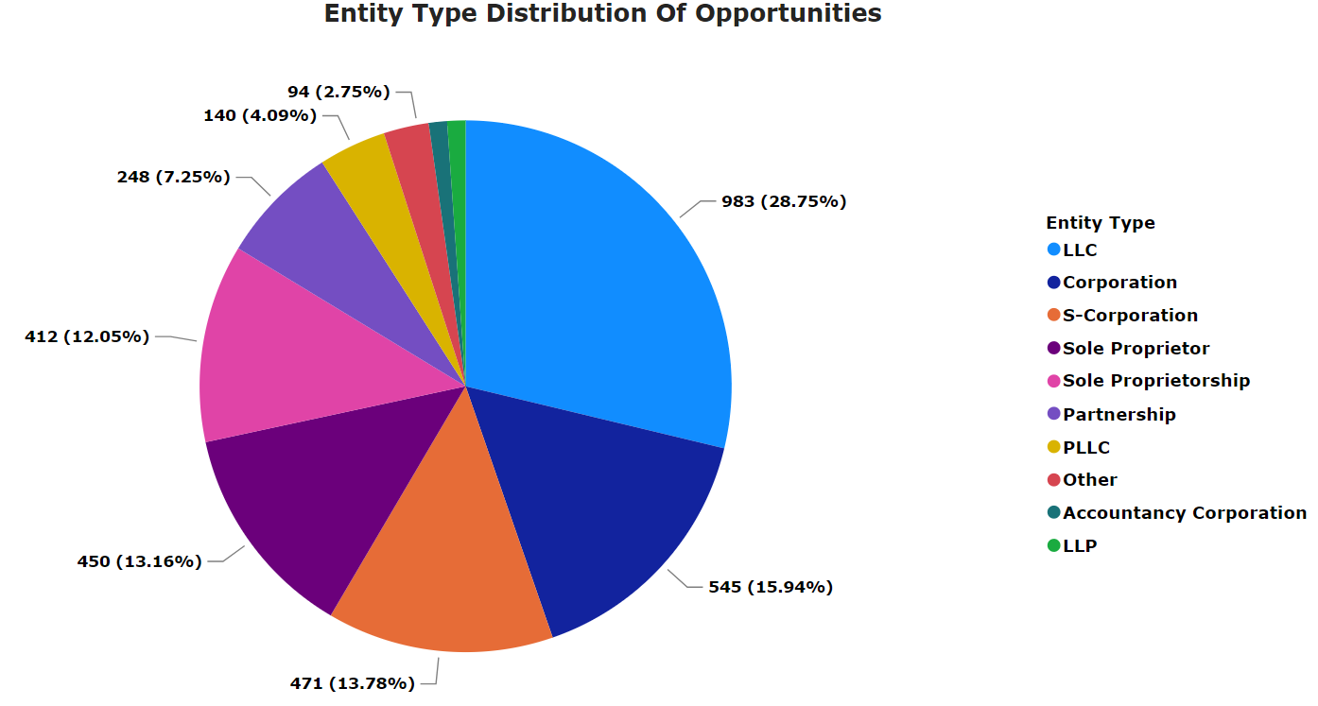
LLC, Sole Proprietor and S-Corporation has given a business boost and lead us to a lot of opportunities
A good strategic planning ensures effective positioning and engagement across these entities, maximizing opportunities in each business entity category.

Slide 7
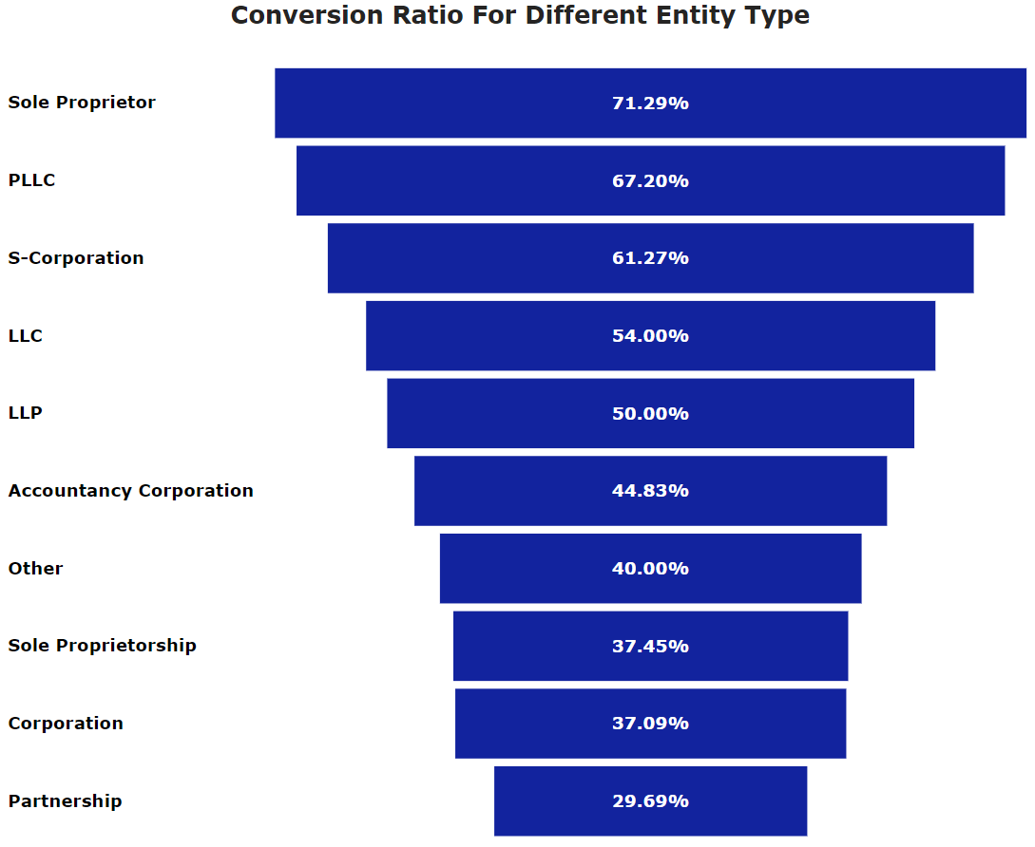
Corporations create lots of chances, but they don't always turn them into success.
Sole Proprietors, PLLC, LLC are doing great. They not only grab opportunities but also turn them into wins. So these entity types convert a lot more opportunities by better planning and focusing.

Slide 8
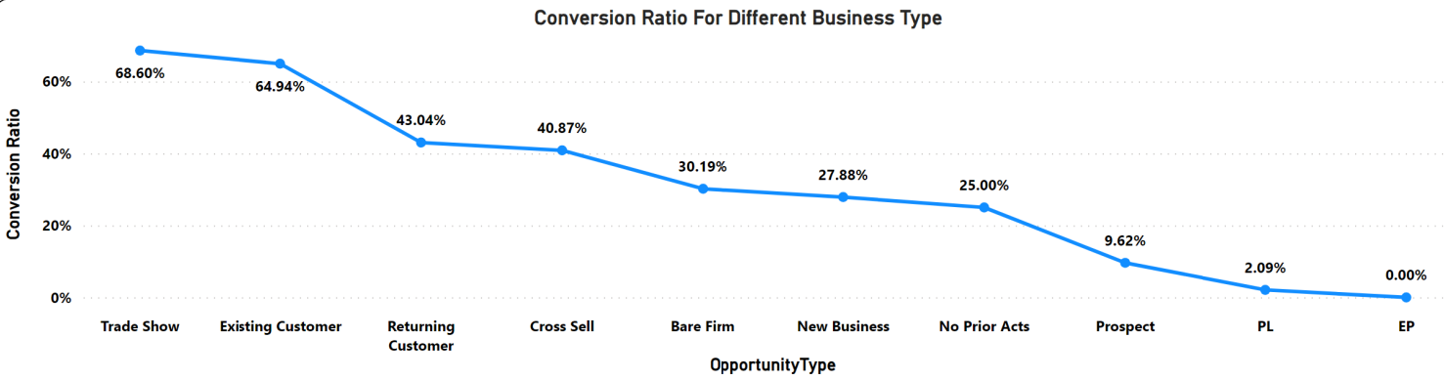
Bare Firms and New Businesses significantly contribute to more generation but face a lower conversion rate.
Strategically tailoring conversion strategies for these segments is recommended to enhance overall sales effectiveness and optimize performance.

Slide 9
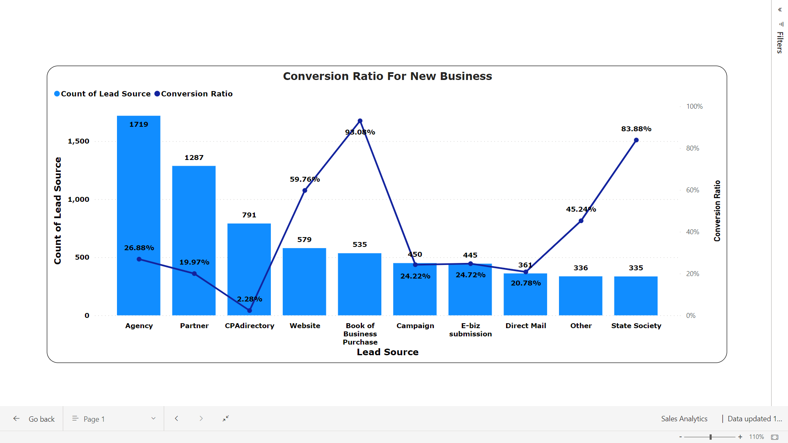
Strategic Focus for Lead Generation and Conversion:
Prioritize high conversion ratio sources like Books of Business Purchases, Websites, and State Society.
Optimize strategies for higher account number sources, including Agency, Partner, and CPAdirectory.
Emphasize improving conversion rates by enhancing lead quality and refining sales approaches.

Slide 10
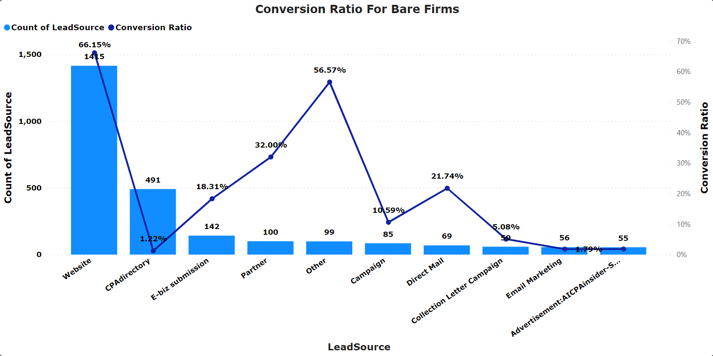
Evaluate performance metrics: CPAdirectory, though with a lower conversion ratio, is the second-highest contributor; the Website leads in both contribution and conversion ratio.
Strategically, prioritize enhancing CPA directory's conversion rate while consistently maintaining and improving the Website's performance. A balanced approach ensures optimal overall sales effectiveness.

Slide 11
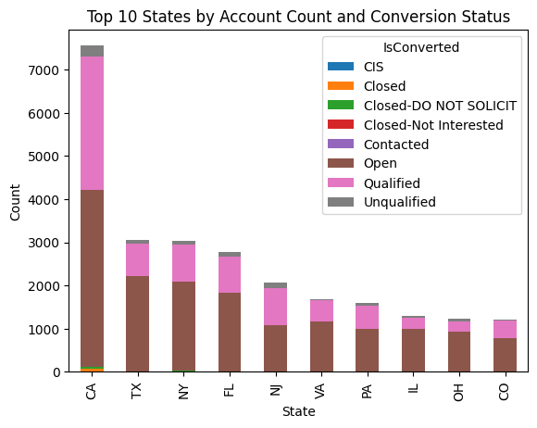
Focus on high-lead volume states: California, Texas, and New York. Direct sales efforts and formulate targeted strategies for these regions.

Slide 12
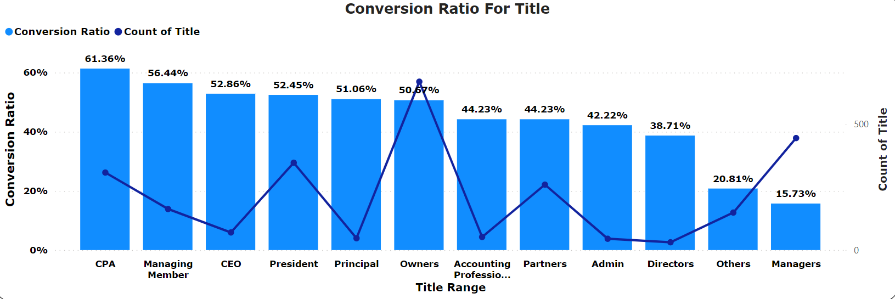
Time-Conversion Relationship:
Average opportunity conversion time: 174 days.
Inverse relationship between time taken and conversion chances, emphasizing the need to optimize processes for quicker conversions and enhance overall sales outcomes.
Lead Title Dynamics:
High contact volume for titles like Owner, Mr., President, Partner, and CPA.
CEO, Managing Manager, and Sole Proprietor show higher conversion percentages, signaling successful closures.

Slide 13
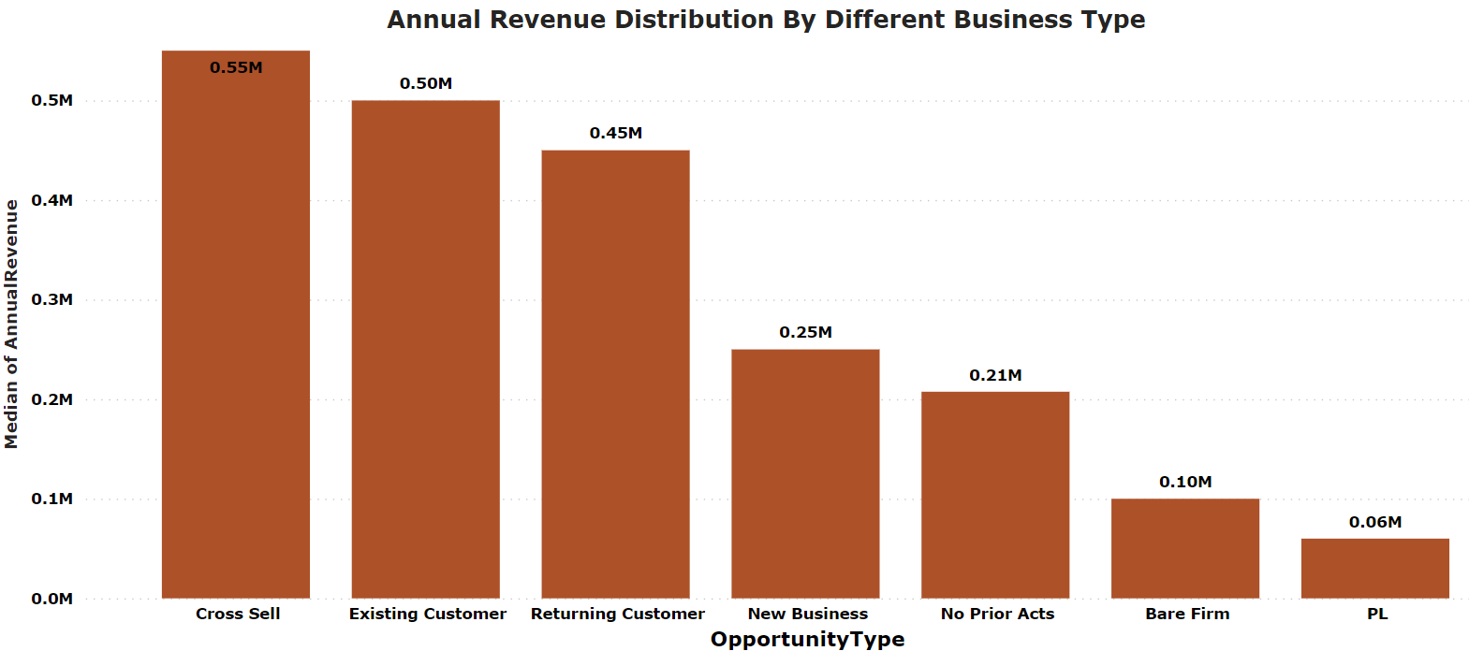
The trend shows EP, cross sell and returning customers has a market dominance and are capable of converting higher revenue opportunities.

Slide 14
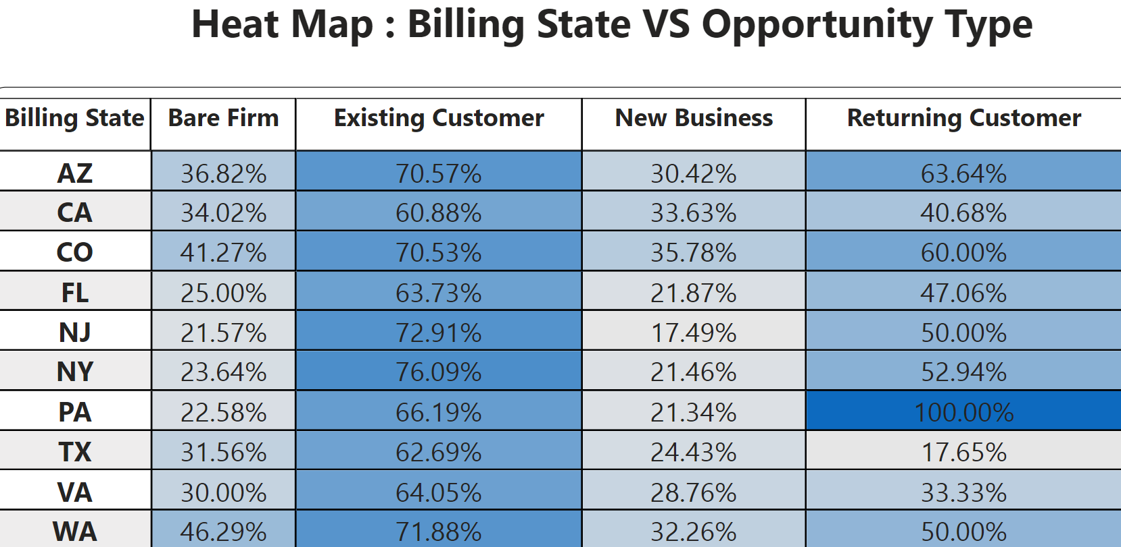
Most of the States are not performing well for new businesses and bare firms.
TX and VA struggle with customer retention.
Customer retention rate is high in PA, AZ, and CO.

